Slide 1
F1- MICRO
Web hosting
31 Jan 2019

Slide 2
Agenda
Existing Architecture
Target Architecture
Way Forward

Slide 3

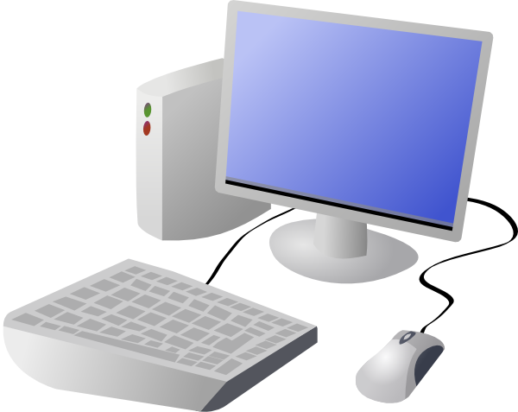
Existing Architecture
This is our present web-hosting architecture, we will move to the next architecture by using Docker.
Domain
Domain provider
Website Data/HTML files
Local computer
Basic HTML Files or word press programming
Cloud

Slide 4
Target Architecture
Docker: It is a container-based development and services that enable you to deploy Docker for local WordPress development,
not only this, with Docker, we can build your WordPress sites,
web apps, databases e.t.c
Docker makes it super easy to move WordPress websites from one platform to another.
Docker doesn’t care if the container runs on Mac, Linux or Windows. The services inside the container are always identical.
Container:
A container is a standard unit of software that packages up code and all its dependencies so the application runs quickly and reliably from one computing environment to another

Slide 5
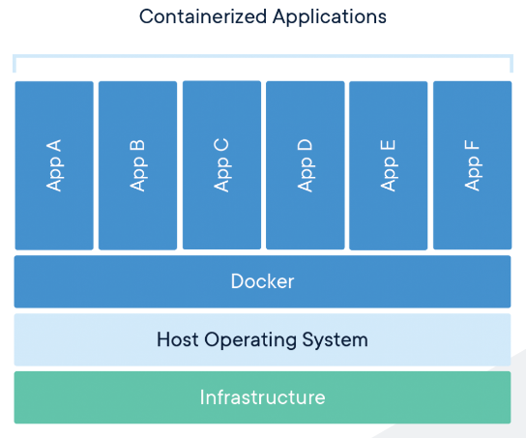
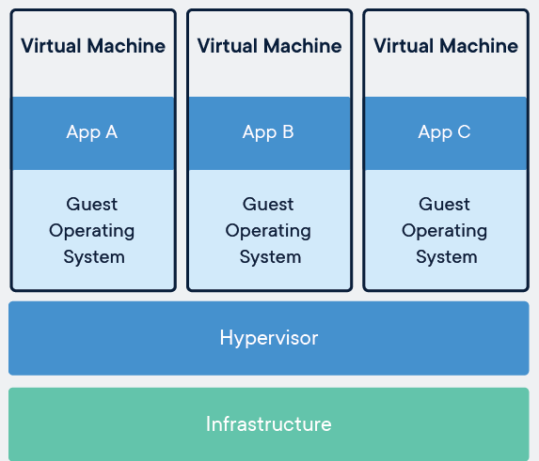
Compare containers and VM’s

Slide 6
Way Forward
Set-up Docker in our windows (set-up instructions/process are updated in manual)
With docker, We should Prepare a simple website(especially our websites “AceEngineer and HairbyLiz”) and slowly add features.

Slide 7
THANK YOU
For the opportunity to serve

Slide 8
Problem Statement
Phase 1 Work:
The website data/html pages need to be relocated from a local computer to a cloud service
Utilize the low (or no) cost options to host a reliable data/html pages
Domains are already purchased using go-Daddy.
Point the domains to a cloud service for data/html pages
Phase 2 Work:
Prepare a simple website in Python Flask
Contain bootstrapping
Should interface with a database (preferably in cloud)

